Slide 1
A Two-Fold Machine Learning Approach to Prevent and Detect IoT Botnet Attacks
20R01A0507 : Ganesh Sai 20R01A0503 : Anoop Kumar Parit 20R01a0505 : Arun Kumar Gupta Guide : Mr. T. Varun

Slide 2
Project analysis slide 2
Project Analysis
Modules
Introduction
PROJECT
Architecture
Problem
Objectives
Architecture
Technologies and algorithms

Slide 3
Introduction:
The rapid proliferation of Internet of Things (IoT) devices has ushered in a new era of connectivity, offering unprecedented convenience and efficiency. However, this interconnected landscape also presents a fertile ground for malicious activities, with IoT devices becoming prime targets for botnet attacks. Botnets, comprised of compromised devices controlled by a single entity, pose a significant threat to the integrity and security of IoT ecosystems.
In this context, a robust and proactive approach to prevent and detect IoT botnet attacks is imperative. Traditional security measures often fall short in addressing the dynamic and evolving nature of these threats. Hence, the adoption of a two-fold machine learning approach emerges as a promising solution, combining prevention and detection mechanisms to fortify IoT environments.

Slide 4
Problem Objective:
The objective of implementing a two-fold machine learning approach is to address the specific challenges posed by IoT botnet threats, aiming to both prevent and detect malicious activities within these interconnected environments.
The overarching problem objective is to enhance the security and resilience of IoT ecosystems against the evolving nature of botnet attacks.
Preventing IoT devices from being compromised and recruited into botnets.
Detect ongoing botnet activities within IoT ecosystems, enabling timely response and containment.
Develop machine learning models that can adapt to the dynamic nature of IoT botnet threats.

Slide 5
Proposed system:
proposed model detects botnet attacks based on a hybrid analysis of flow-based and graph-based network traffic behaviors. The flow-based detection is performed by k-means, which calculates the similarity and stability scores between flows.
The proposed solution specifically considered network traffic flows, which are further converted into feature records and then passed to the deep neural network (DNN) model for IoT botnet attack detection.
Disadvantages
An existing methodology prevents botnet attacks by detecting the scanning attack activity while it detects the botnet attack by identifying the DDoS attack for both inbound and outbound traffic.
IoT botnet attack doesn't initiates with the scanning activity and ends at the DDoS attack.

Slide 6
Existed system:
The system proposed a two-fold machine learning approach to prevent and detect both inbound and outbound botnet attacks in the IoT network environment. The proposed two-fold approach prevents IoT botnet attacks by detecting the scanning activity, while it detects the IoT botnet attack by identifying the DDoS attack.
The proposed solution specifically considered network traffic flows, which are further converted into feature records and then passed to the deep neural network (DNN) model for IoT botnet attack detection.
Advantages
The system proposed a novel two-fold machine learning approach to prevent and detect botnet attacks in IoT networks.
The proposed methodology stops an attacker during the scanning activity so that an attacker cannot proceed to further attack stages.

Slide 7
Hardware and software requirements:
HARDWARE REQUIREMENTS:
➢ Processor - Pentium –IV
➢ RAM - 4 GB (min)
➢ Hard Disk - 20 GB
➢ Key Board - Standard
Windows Keyboard
➢ Mouse - Two or Three Button
➢ Monitor - SVGA
SOFTWARE REQUIREMENTS:
Operating system : Windows 7 Ultimate.
Coding Language : Python.
Front-End : Python.
Back-End : Django-ORM
Designing : Html, css, javascript.
Data Base : MySQL (WAMP Server).

Slide 8
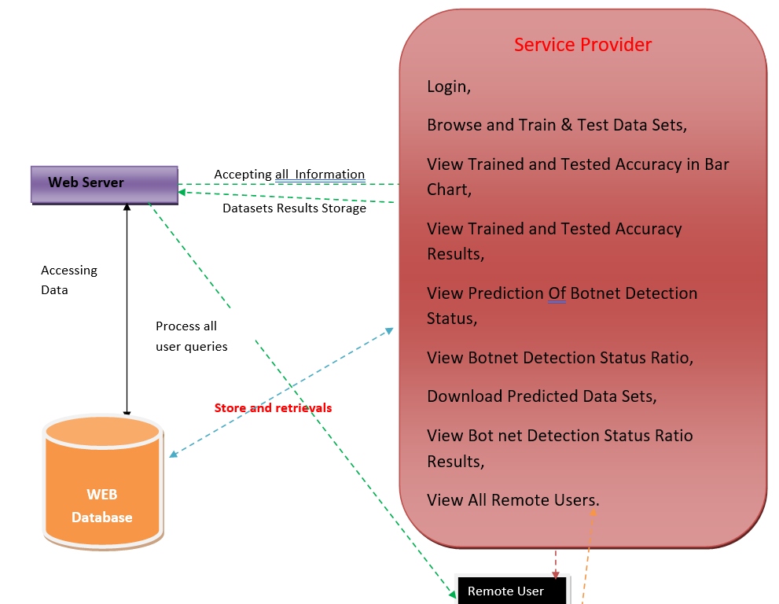
Architecture:

Slide 9
Modules:
Service Provider
In this module, the Service Provider has to login by using valid user name and password. After login successful he can do some operations such as Login, Browse and Train & Test Data Sets, View Trained and Tested Accuracy in Bar Chart, View Trained and Tested Accuracy Results, View Prediction Of Botnet Detection Status, View Botnet Detection Status Ratio, Download Predicted Data Sets, View Botnet Detection Status Ratio Results, View All Remote Users.
View and Authorize Users
In this module, the admin can view the list of users who all registered. In this, the admin can view the user’s details such as, user name, email, address and admin authorizes the users.
Remote User
In this module, there are n numbers of users are present. User should register before doing any operations. Once user registers, their details will be stored to the database. After registration successful, he has to login by using authorized user name and password. Once Login is successful user will do some operations like
REGISTER AND LOGIN PREDICT BOTNET DETECTION TYPE, VIEW YOUR PROFILE.

Slide 10
Thank You

